Slide 1
INFO 5731 - Computational Methods for Information Systems
Classification Evaluation
Haihua Chen, Ph.D.
University of North Texas

Slide 2
Classification Evaluation

Slide 3
Classification evaluation:
N-fold cross-validation: Split dataset into N folds. Runs test N times. At a time, use one-fold of data as test set, remaining N - 1 folds of data as training sets. Classification accuracy is average of results in N runs.
Hold-out test: Divide dataset into training and test subsets. Varied splits will result in varied results and accuracy, especially for small datasets. Paired t-test can be used to measure significance in accuracy differences.
Evaluation metrics: Accuracy, recall, precision, F-score

Slide 4
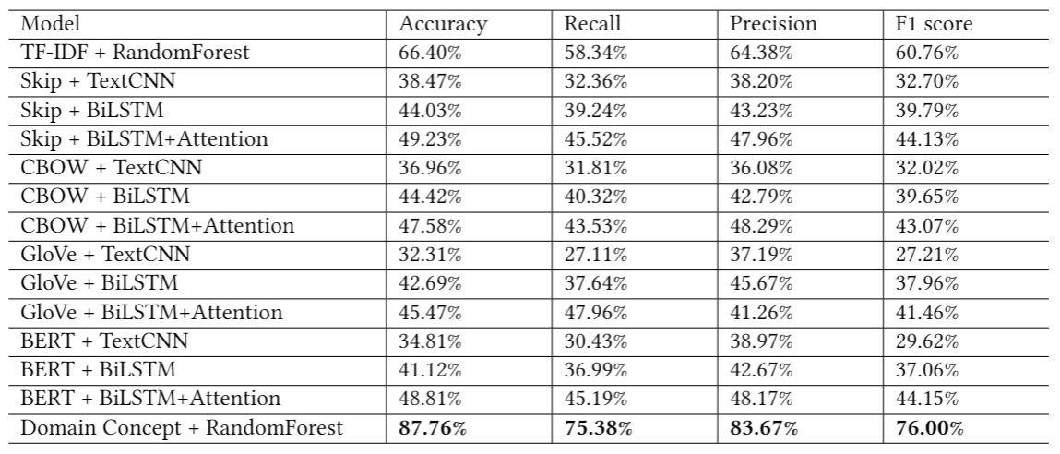
Common Evaluation Metrics
Accuracy
Precision
Recall
F-measure
harmonic mean of recall and precision
micro-average F1: global calculation of F1 regardless of topics
macro-average F1: average on F1 scores of all the topics
An example of evaluation report for text classification
Source: Chen, H., Wu, L., Chen, J., Lu, W., & Ding, J. (2022). A comparative study of automated legal text classification using random forests and deep learning. Information Processing & Management, 59(2), 102798.

Slide 5
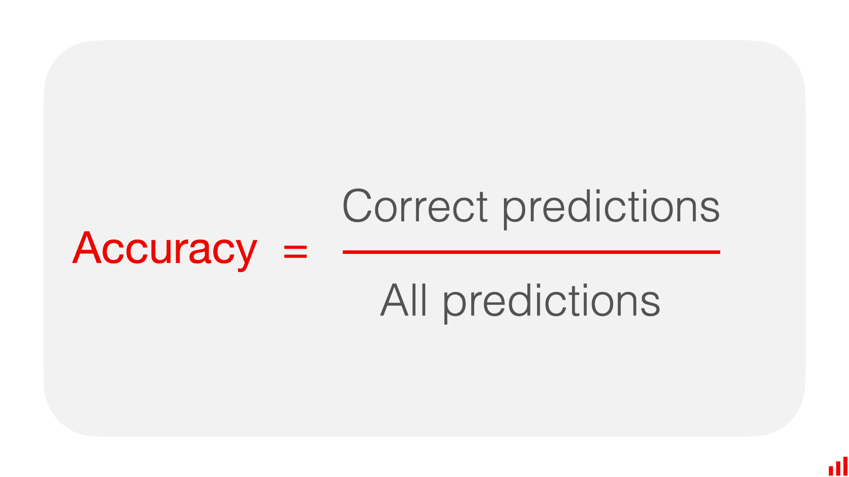
Accuracy
What is accuracy? Accuracy is a metric that measures how often a machine learning model correctly predicts the outcome. You can calculate accuracy by dividing the number of correct predictions by the total number of predictions.
Source: https://www.evidentlyai.com/classification-metrics/accuracy-precision-recall
Notes:
https://www.evidentlyai.com/classification-metrics/accuracy-precision-recall

Slide 6
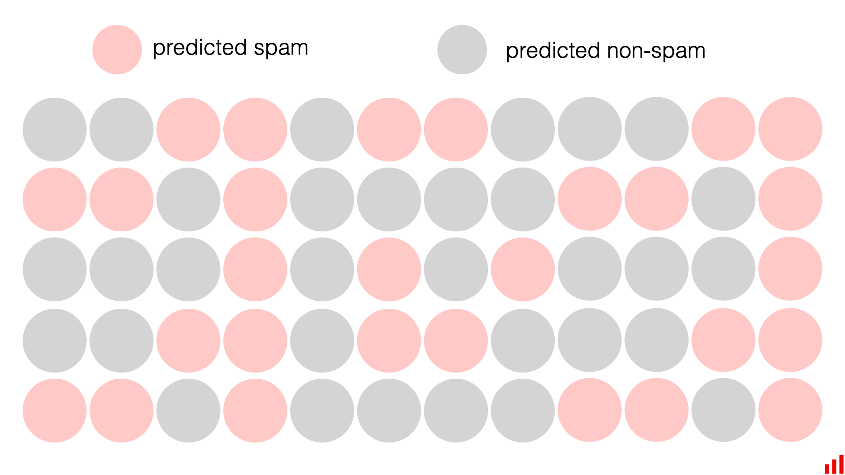
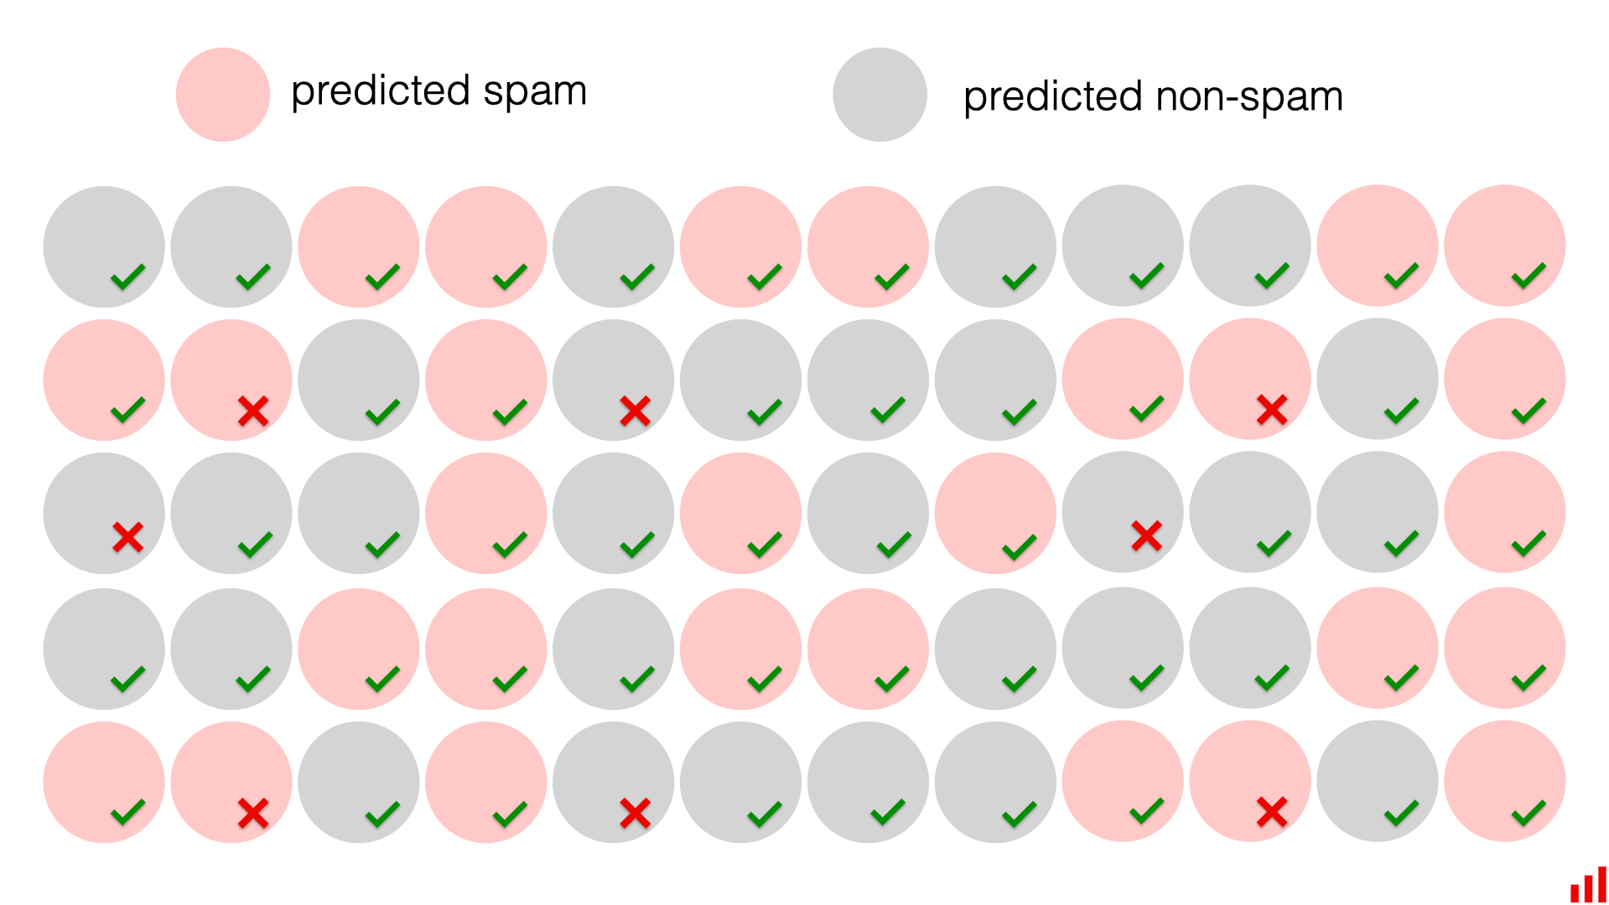
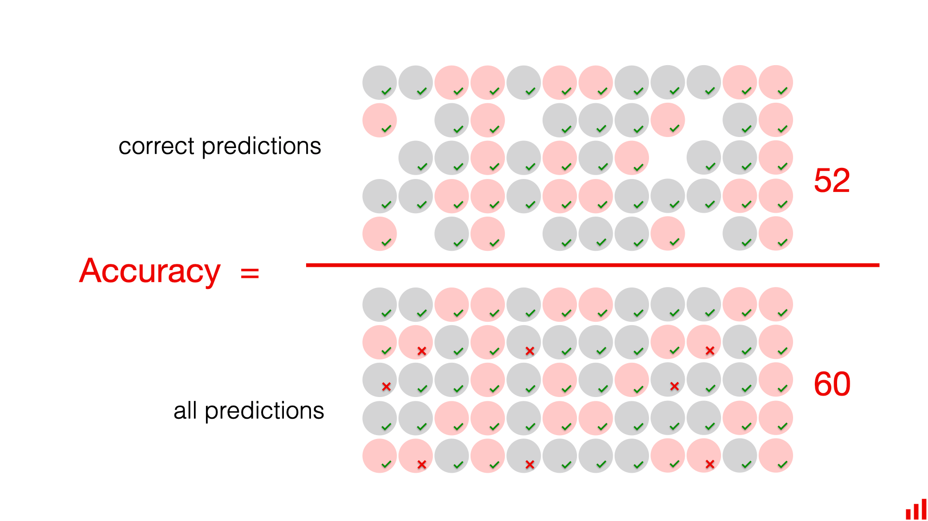
Accuracy (visual example)
Source: https://www.evidentlyai.com/classification-metrics/accuracy-precision-recall
Notes:
https://www.evidentlyai.com/classification-metrics/accuracy-precision-recall

Slide 7
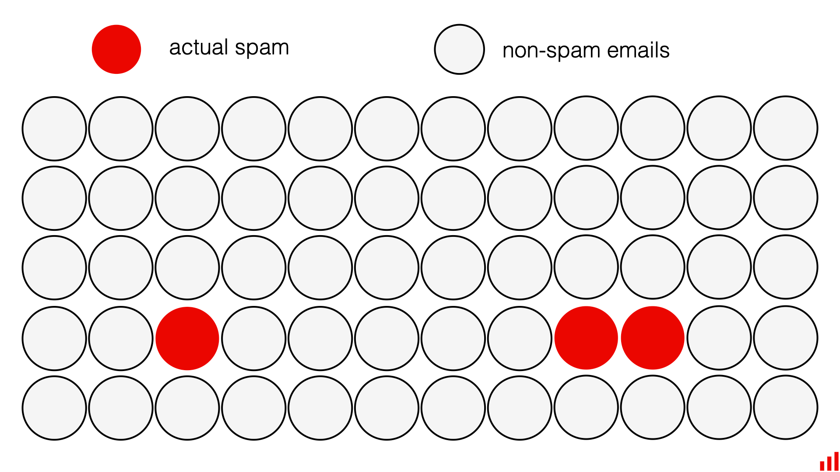
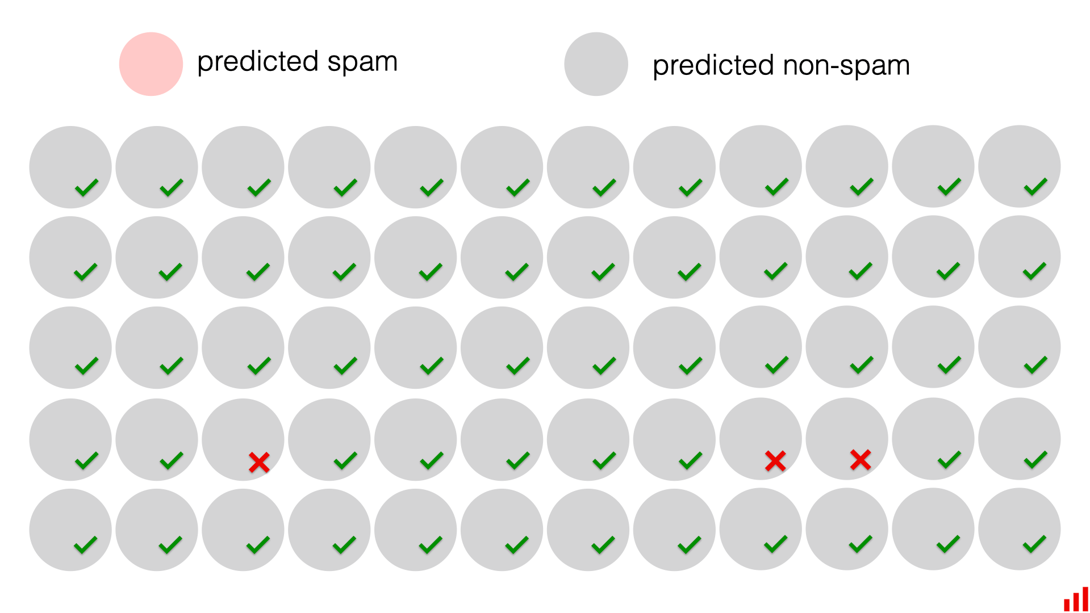
Accuracy (Issues)
In this specific example, the accuracy is 95%: yes, the model missed every spam email, but it was still right in 57 cases out of 60.
However, this accuracy is now meaningless. The model does not serve the primary goal and does not help identify the target event.
Source: https://www.evidentlyai.com/classification-metrics/accuracy-precision-recall

Slide 8
Accuracy (Pros and cons)
Pros:
Accuracy is a helpful metric when you deal with balanced classes and care about the overall model “correctness” and not the ability to predict a specific class.
Accuracy is easy to explain and communicate.
Cons:
If you have imbalanced classes, accuracy is less useful since it gives equal weight to the model’s ability to predict all categories.
Communicating accuracy in such cases can be misleading and disguise low performance on the target class.
Source: https://www.evidentlyai.com/classification-metrics/accuracy-precision-recall

Slide 9
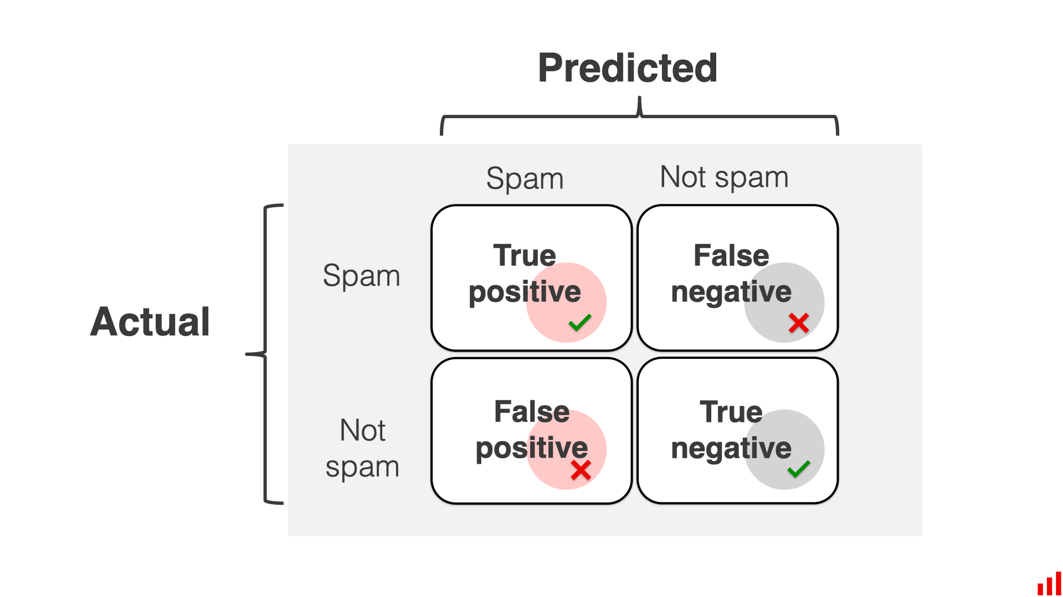
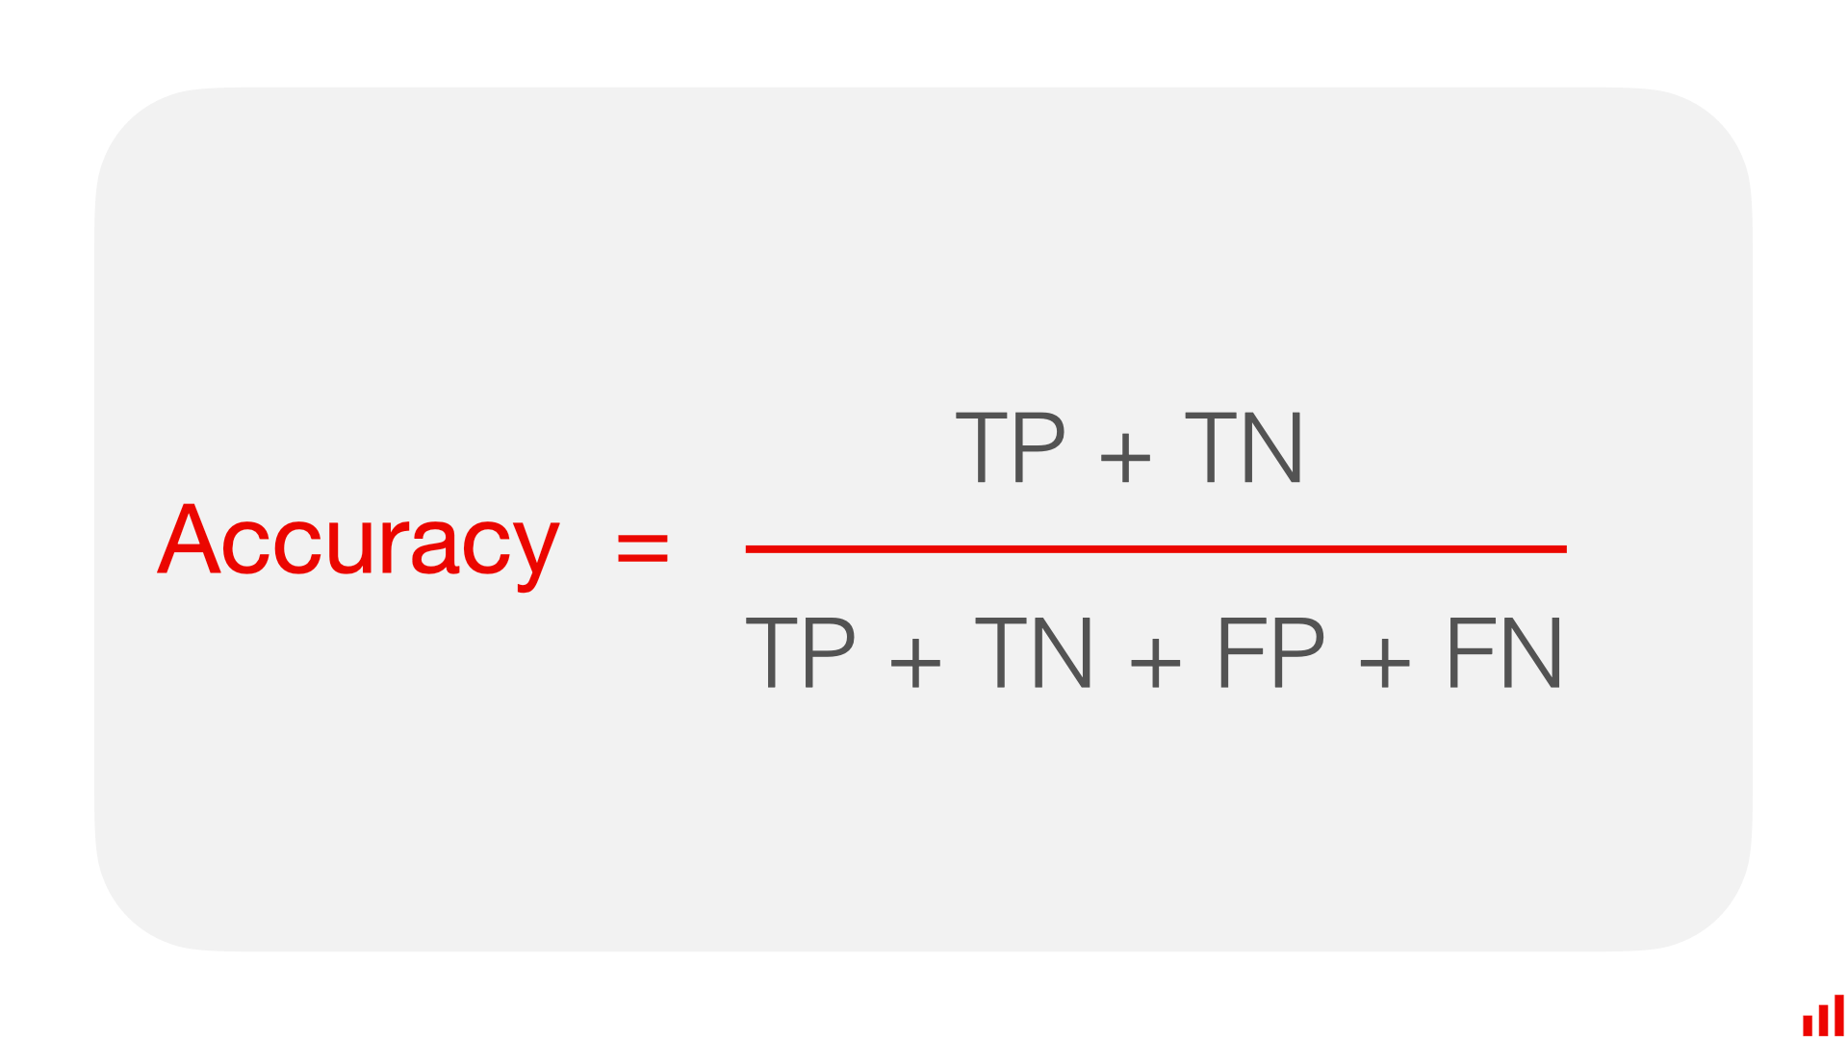
Confusion matrix
Source: https://www.evidentlyai.com/classification-metrics/accuracy-precision-recall

Slide 10
Confusion matrix
Correct predictions include so-called true positives and true negatives. This is how it unpacks for our spam use case example:
True positive (TP): An email that is actually spam and is correctly classified by the model as spam.
True negative (TN): An email that is actually not spam and is correctly classified by the model as not spam.
Model errors include so-called false positives and false negatives. In our example:
False Positive (FP): An email that is actually not spam but is incorrectly classified by the model as spam (a "false alarm").
False Negative (FN): An email that is actually spam but is incorrectly classified by the model as not spam (a "missed spam").
Source: https://www.evidentlyai.com/classification-metrics/accuracy-precision-recall

Slide 11
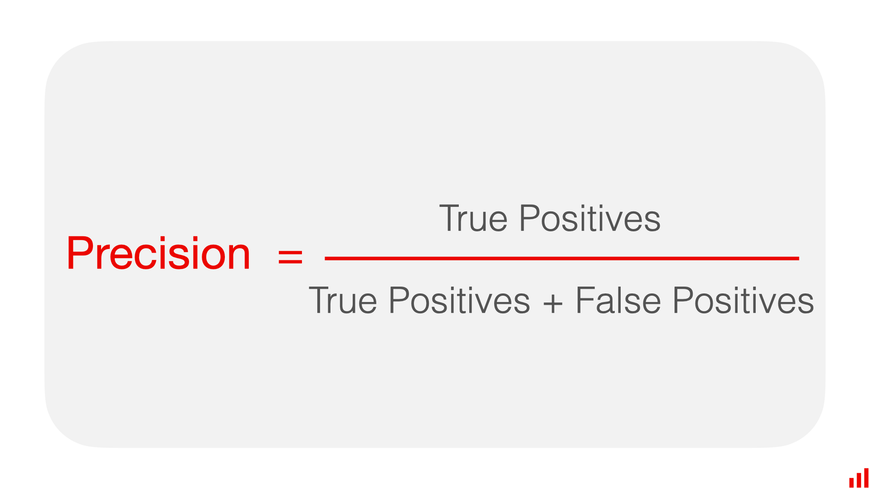
Precision
Precision is a metric that measures how often a machine learning model correctly predicts the positive class. You can calculate precision by dividing the number of correct positive predictions (true positives) by the total number of instances the model predicted as positive (both true and false positives).
Source: https://www.evidentlyai.com/classification-metrics/accuracy-precision-recall

Slide 12
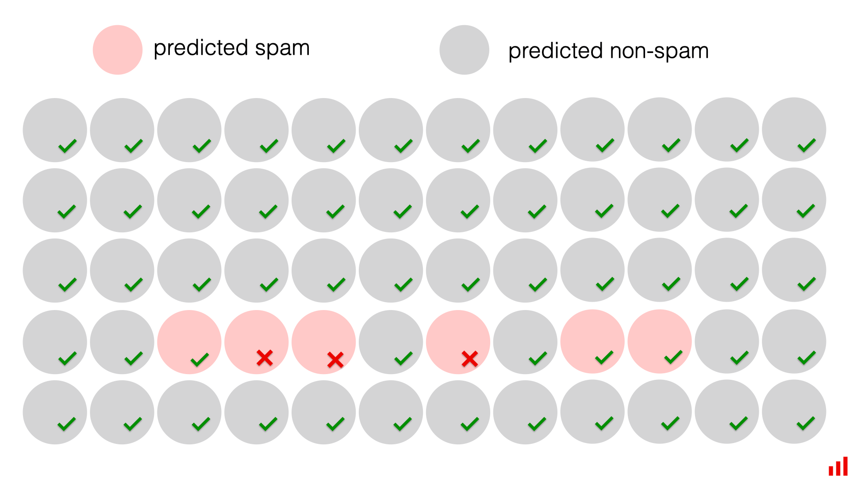
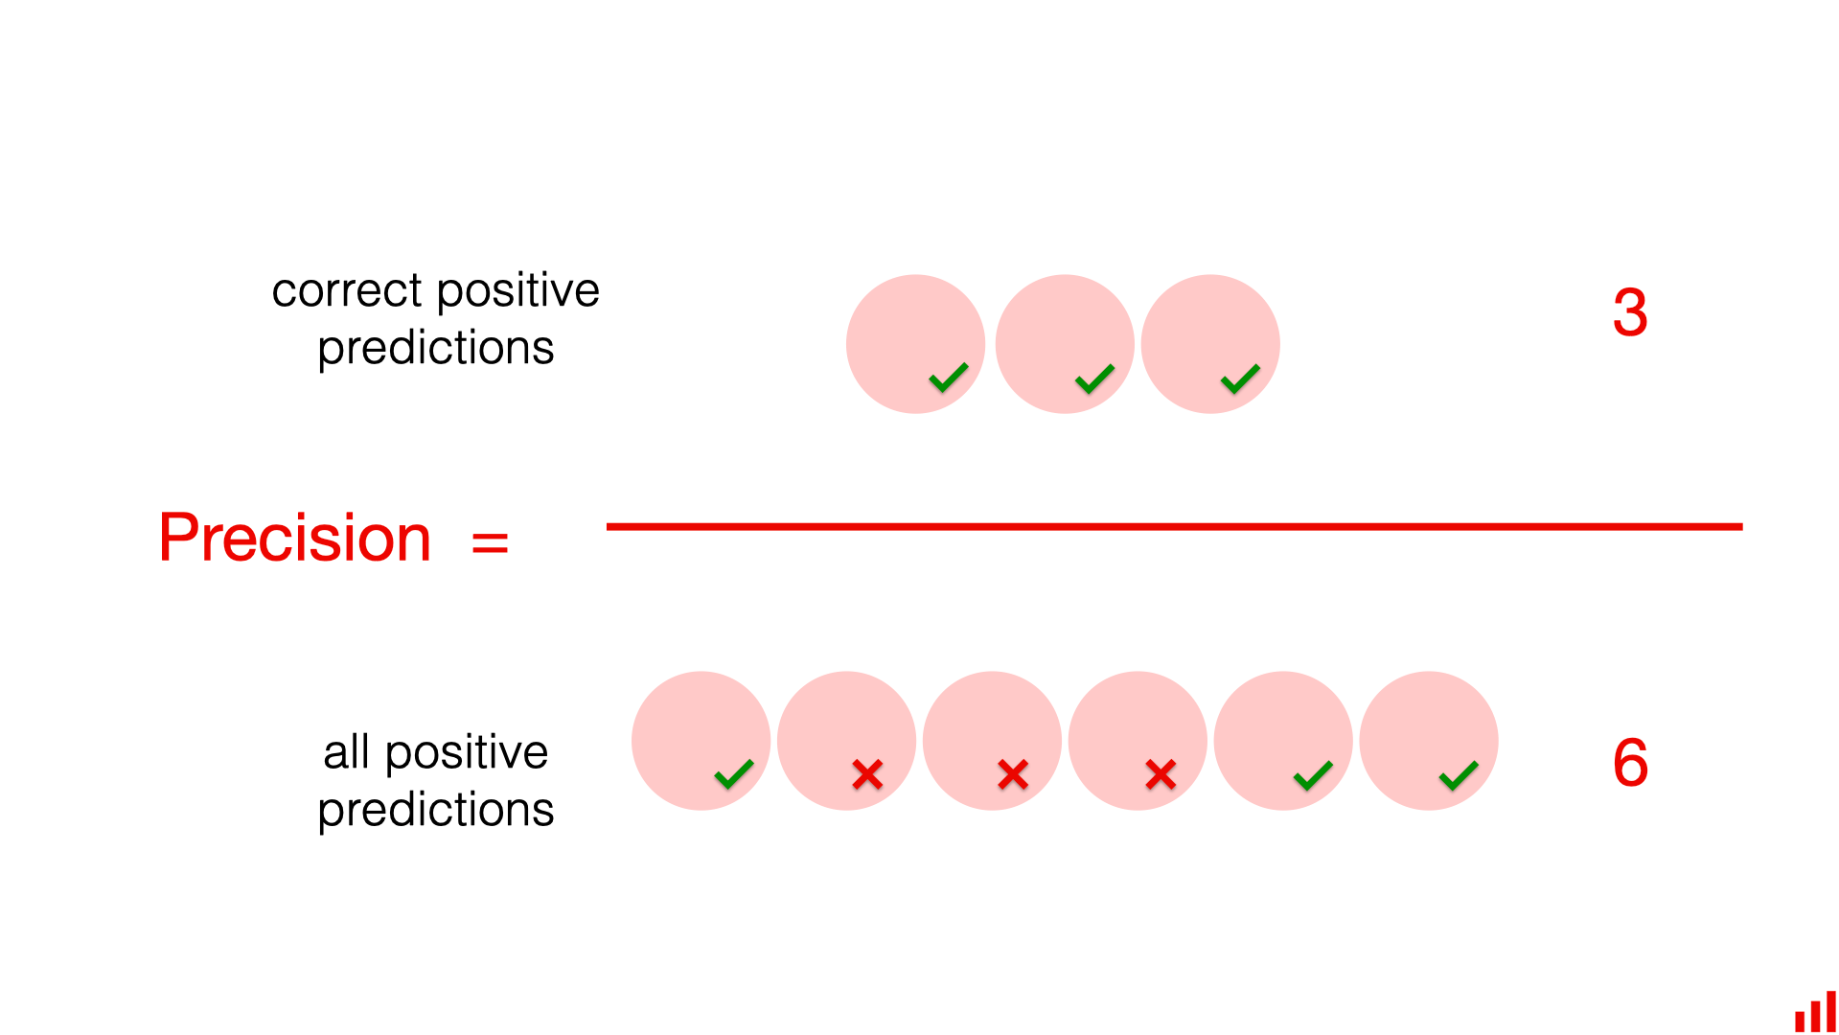
Precision (Visual example)
Source: https://www.evidentlyai.com/classification-metrics/accuracy-precision-recall

Slide 13
Precision (Issues)
Let’s first try the same trick that we did with accuracy. We simply predict that all emails are non-spam (right).
To calculate the precision, we must divide the number of correctly predicted spam emails by their total number. However, the number of correctly identified spam emails is 0. There were 3 spam emails in the dataset, and the model missed them all. All the correct predictions were about non-spam emails. This way, the precision metric corrects for the major downside of accuracy. It clearly communicates that our non-existent model does not solve the problem.
Source: https://www.evidentlyai.com/classification-metrics/accuracy-precision-recall

Slide 14
Precision (Pros and cons)
Here are the pros of the precision metric:
It works well for problems with imbalanced classes since it shows the model correctness in identifying the target class.
Precision is useful when the cost of a false positive is high. In this case, you typically want to be confident in identifying the target class, even if you miss out on some (or many) instances.
Here is the main con of precision:
Precision does not consider false negatives. Meaning: it does not account for the cases when we miss our target event!
Source: https://www.evidentlyai.com/classification-metrics/accuracy-precision-recall

Slide 15
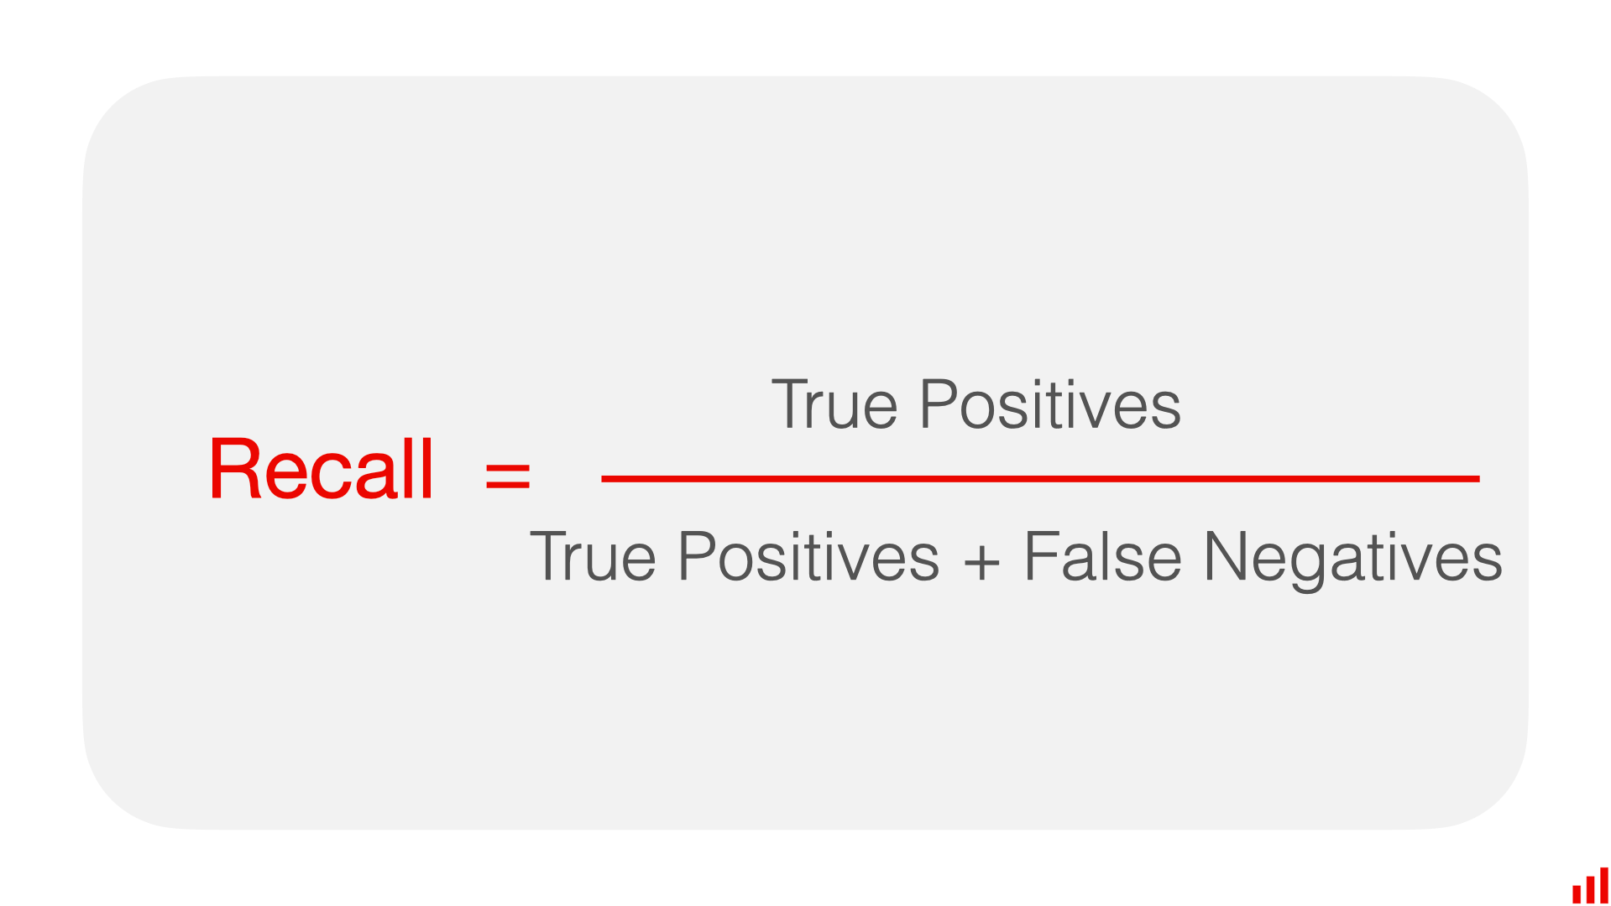
Recall
Recall is a metric that measures how often a machine learning model correctly identifies positive instances (true positives) from all the actual positive samples in the dataset. You can calculate recall by dividing the number of true positives by the number of positive instances. The latter includes true positives (successfully identified cases) and false negative results (missed cases).
Source: https://www.evidentlyai.com/classification-metrics/accuracy-precision-recall

Slide 16
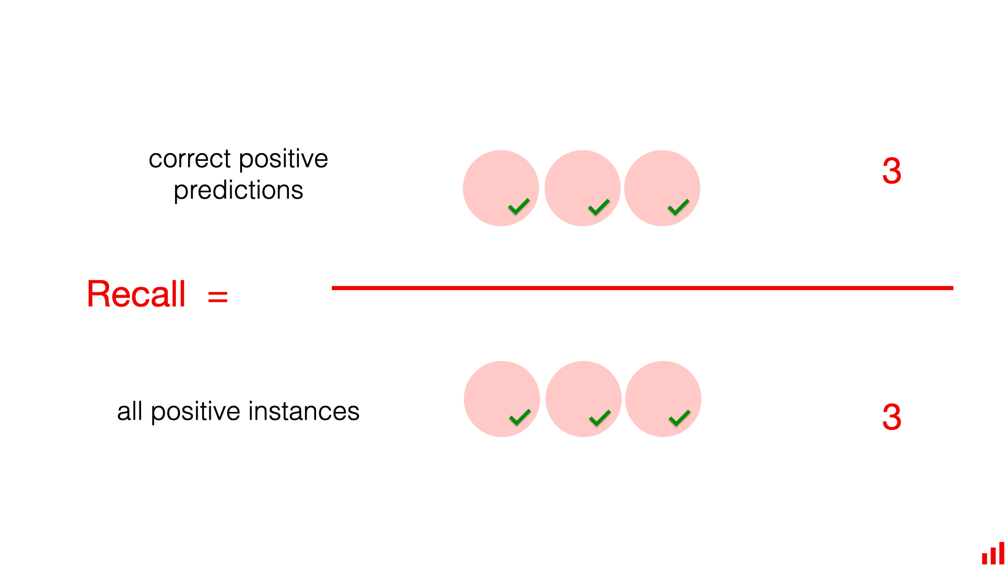
Recall (Visual example)
Source: https://www.evidentlyai.com/classification-metrics/accuracy-precision-recall

Slide 17
Recall (Pros and cons)
Here are the pros of the recall metric:
It works well for problems with imbalanced classes since it is focused on the model’s ability to find objects of the target class.
Recall is useful when the cost of false negatives is high. In this case, you typically want to find all objects of the target class, even if this results in some false positives (predicting a positive when it is actually negative).
Here is the downside of recall:
Recall is that it does not account for the cost of these false positives.
Source: https://www.evidentlyai.com/classification-metrics/accuracy-precision-recall

Slide 18
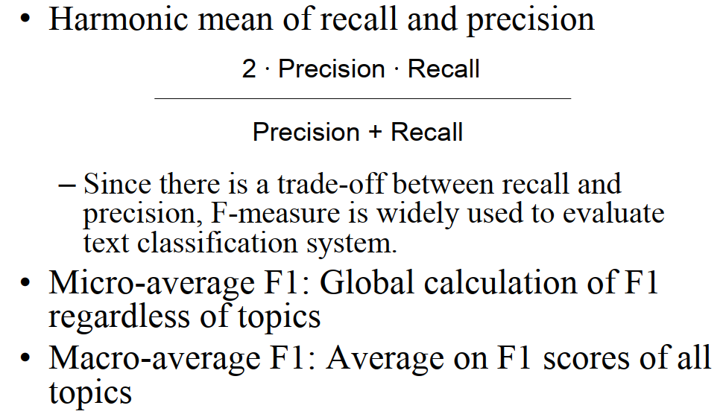
F-measure
Source: Created by our own

Slide 19
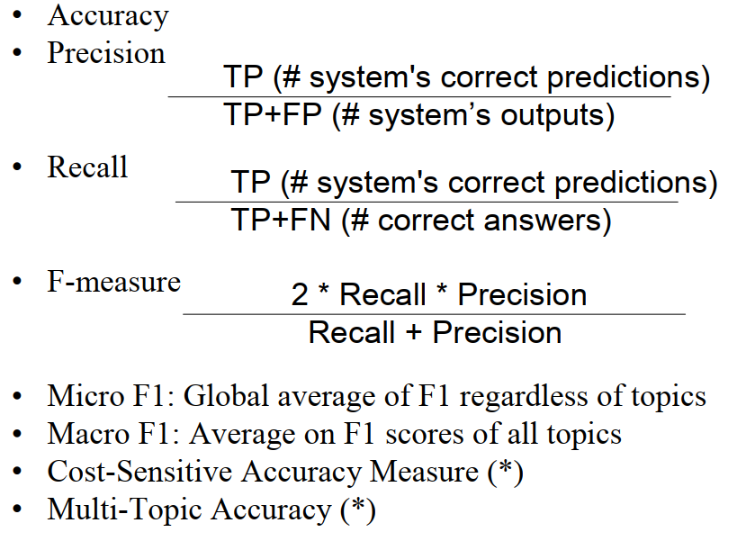
Summary of text classification evaluation
Source: Created by our own

Slide 20
Summary of text classification evaluation
A more detailed example of evaluating classification models with code: https://www.evidentlyai.com/blog/tutorial-2-model-evaluation-hr-attrition

Slide 21
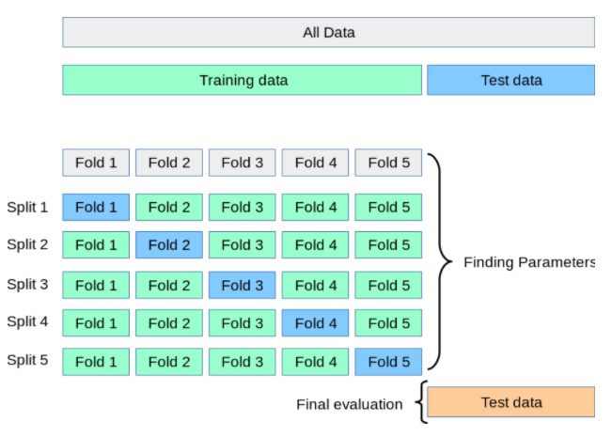
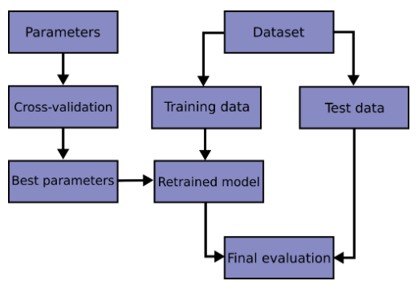
Cross-validation
Source: https://scikit-learn.org/stable/modules/cross_validation.html
Notes:
https://scikit-learn.org/stable/modules/cross_validation.html

Slide 22
Thank you!

